Slide 1
Building a Car
Ctrl+Alt+Elite

Slide 2
Wheels
When looking at the side of the gearbox with screws and the wires at the top, the motor will turn clockwise when given positive polarity to the left lead, and negative connection to the right lead
When putting leads on wheels, a darker wire (Green, Blue, Black) should be on the right side, and a lighter wire (Yellow, White, Red) should be on the left side
Notes:
This slide indicates the way the leads should be hooked up to the motors, this should not be part of the slide show unless it is intended for the students to solder the connections themselves

Slide 3
List of Materials
Components
Arduino
Mini-Breadboard
H-bridge
2 Wheels + Gearboxes
M/F Jumper Wires
M/M Jumper Wires
9V Battery
9V Battery cable
Ball bearing
Foam square (10cm x 12cm)
Tools
Scissors
Double sided tape

Slide 4
Learning objectives
By the end of this unit, you should be able to
Identify and understand how an H-Bridge motor driver works
Use an H-Bridge motor driver to control speed and direction of motors
Build a simple car using knowledge from previous units

Slide 5
Section 1:
H-Bridge Motor Driver

Slide 6
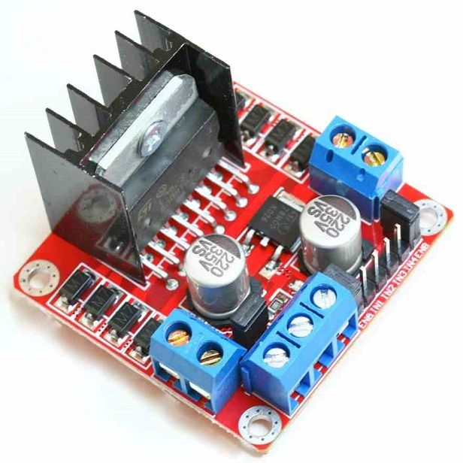
Learning objectives
In this section we will learn about
What is an H-bridge motor driver
How the H-bridge motor driver works
Using the H-bridge motor driver

Slide 7
Intro to H-Bridge Motor Driver
The Arduino doesn’t have enough power to turn the wheels on its own
So we will use an H-bridge motor driver (H-bridge)

Slide 8
Intro to H-Bridge Motor Driver
The H-bridge allows us to
Use the logic of the arduino while using the external power of the battery
control the direction of the motors
speed of the motors

Slide 9
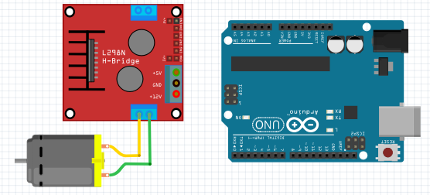
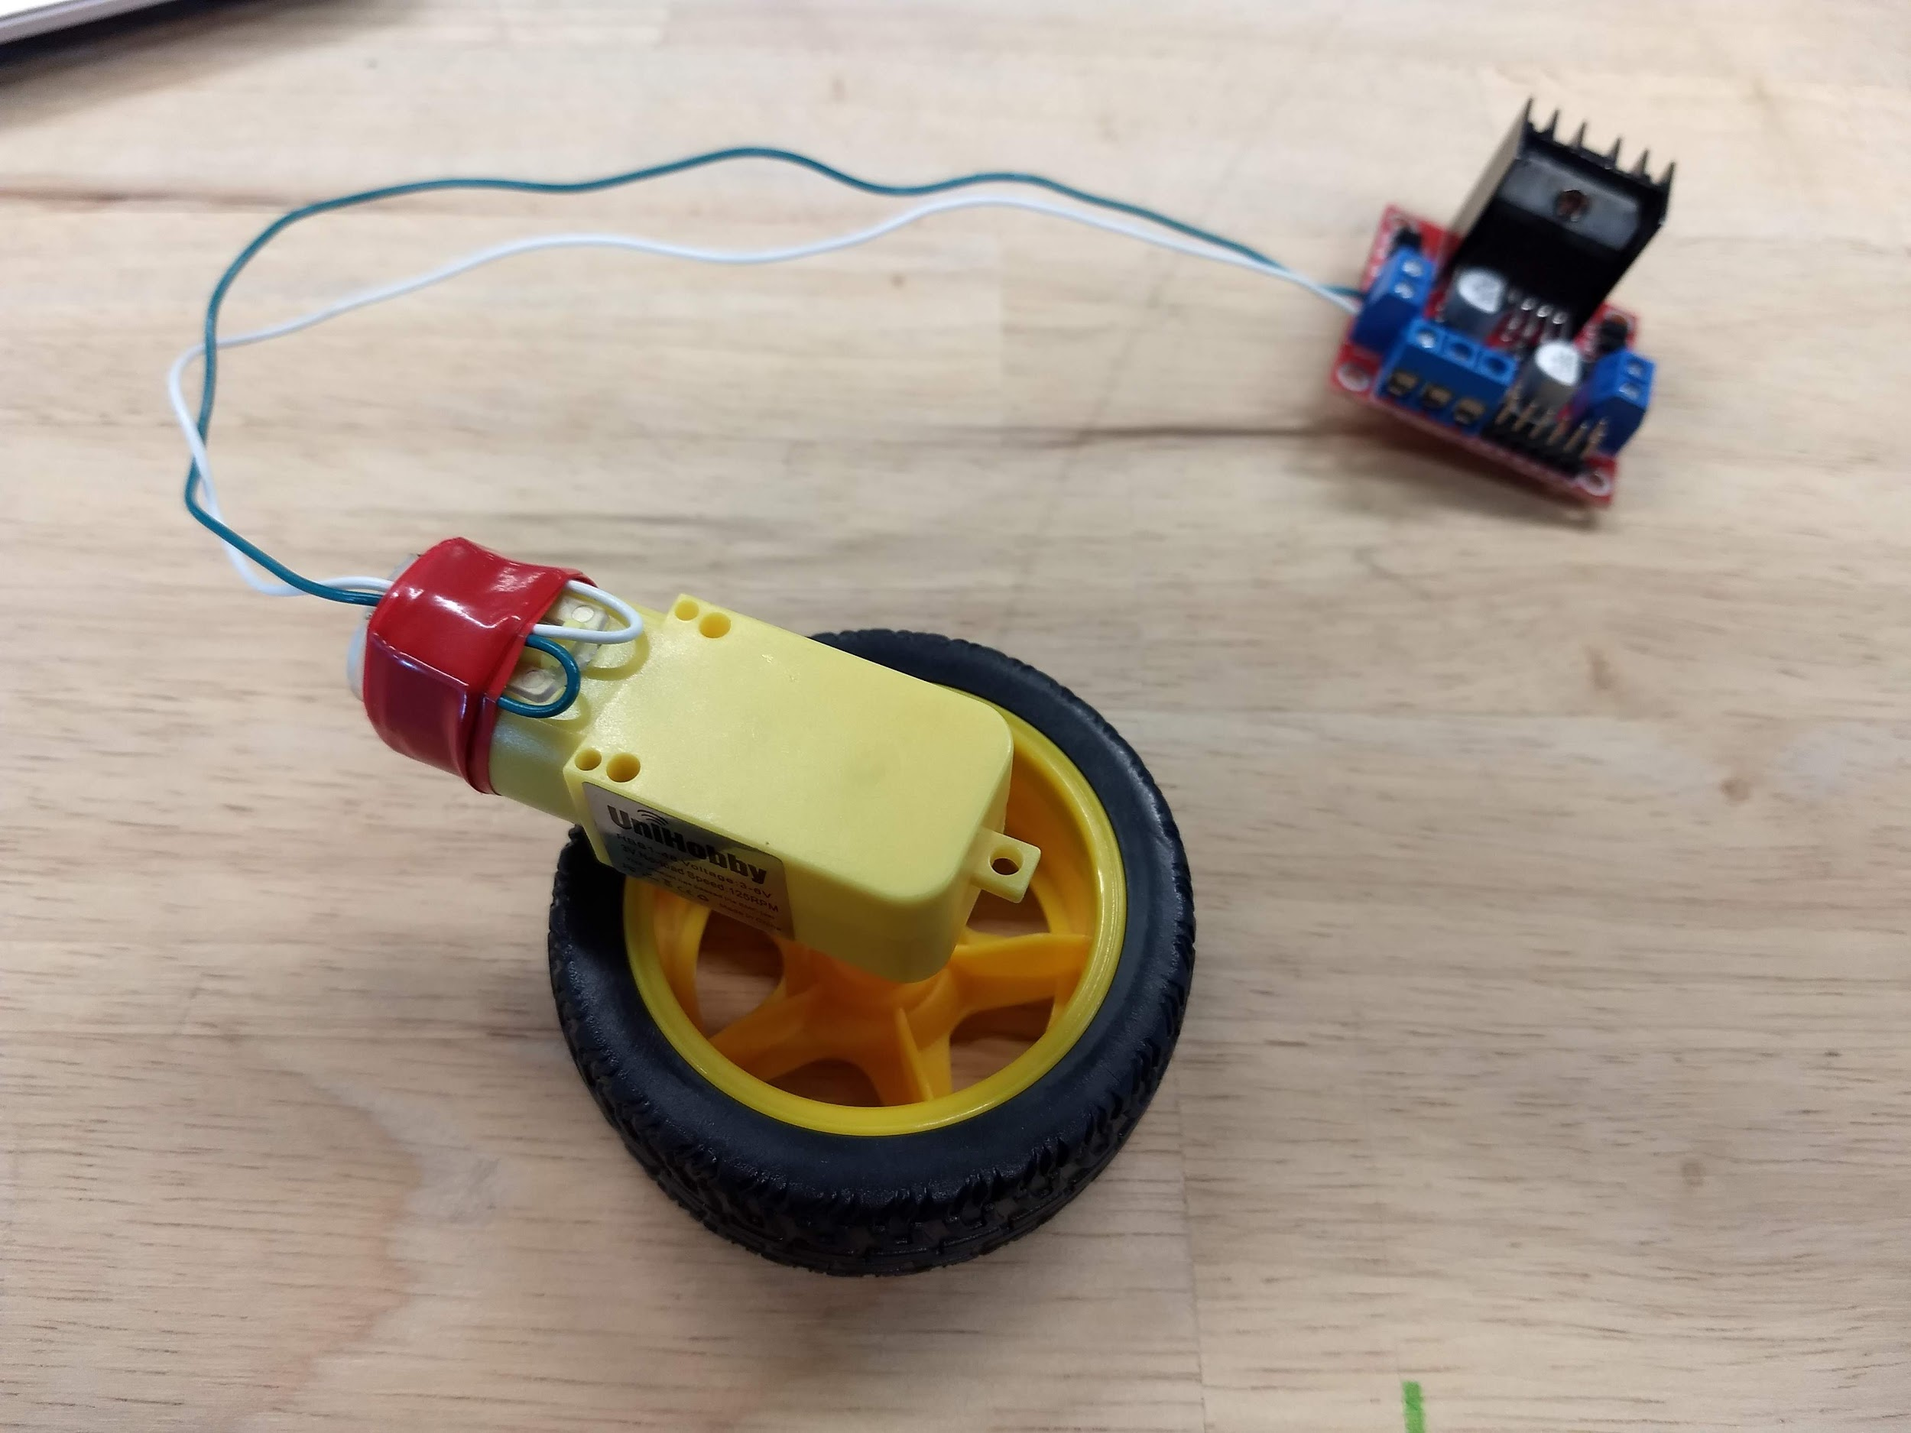
H-Bridge mini project (Assembly)
Connect the leads of a wheel to the motor A output on the H-bridge

Slide 10
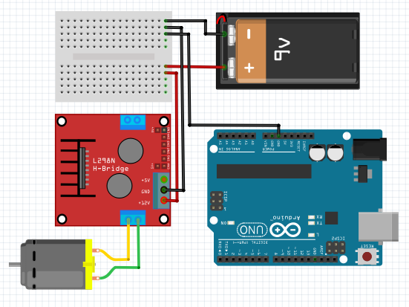
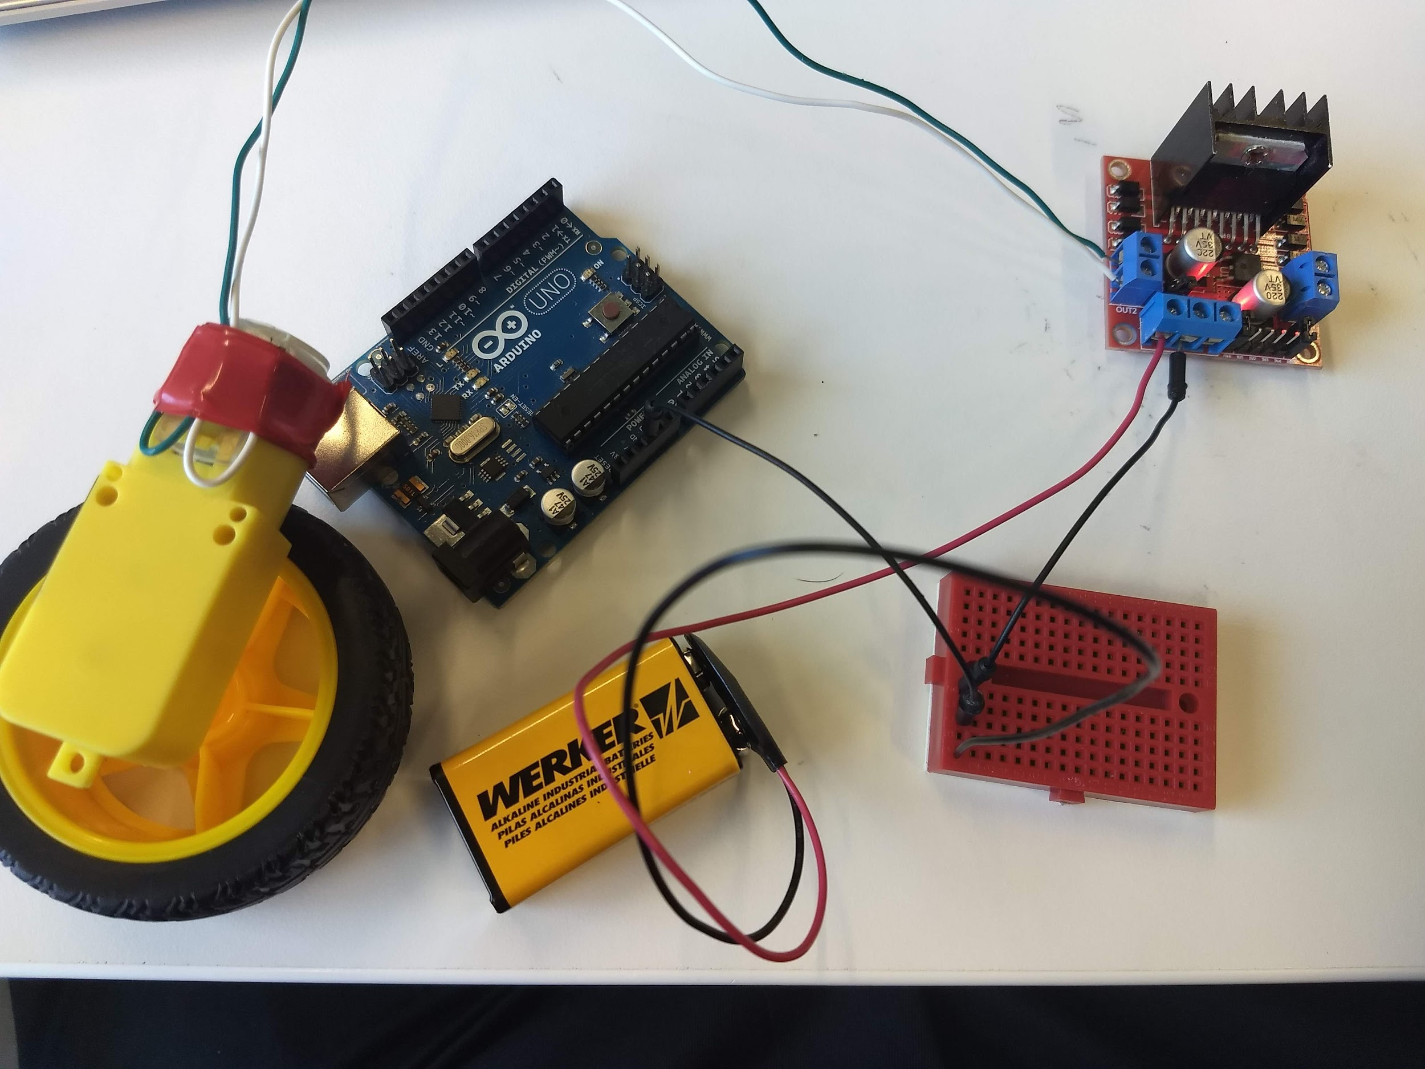
H-Bridge mini project (Assembly)
Using a breadboard, connect the battery + to both the H-Bridge and the Arduino, and the battery - to h bridge

Slide 11
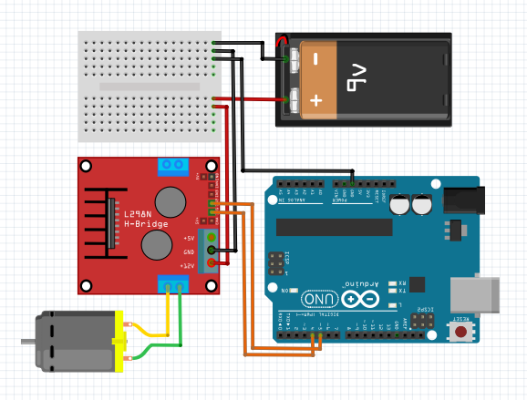
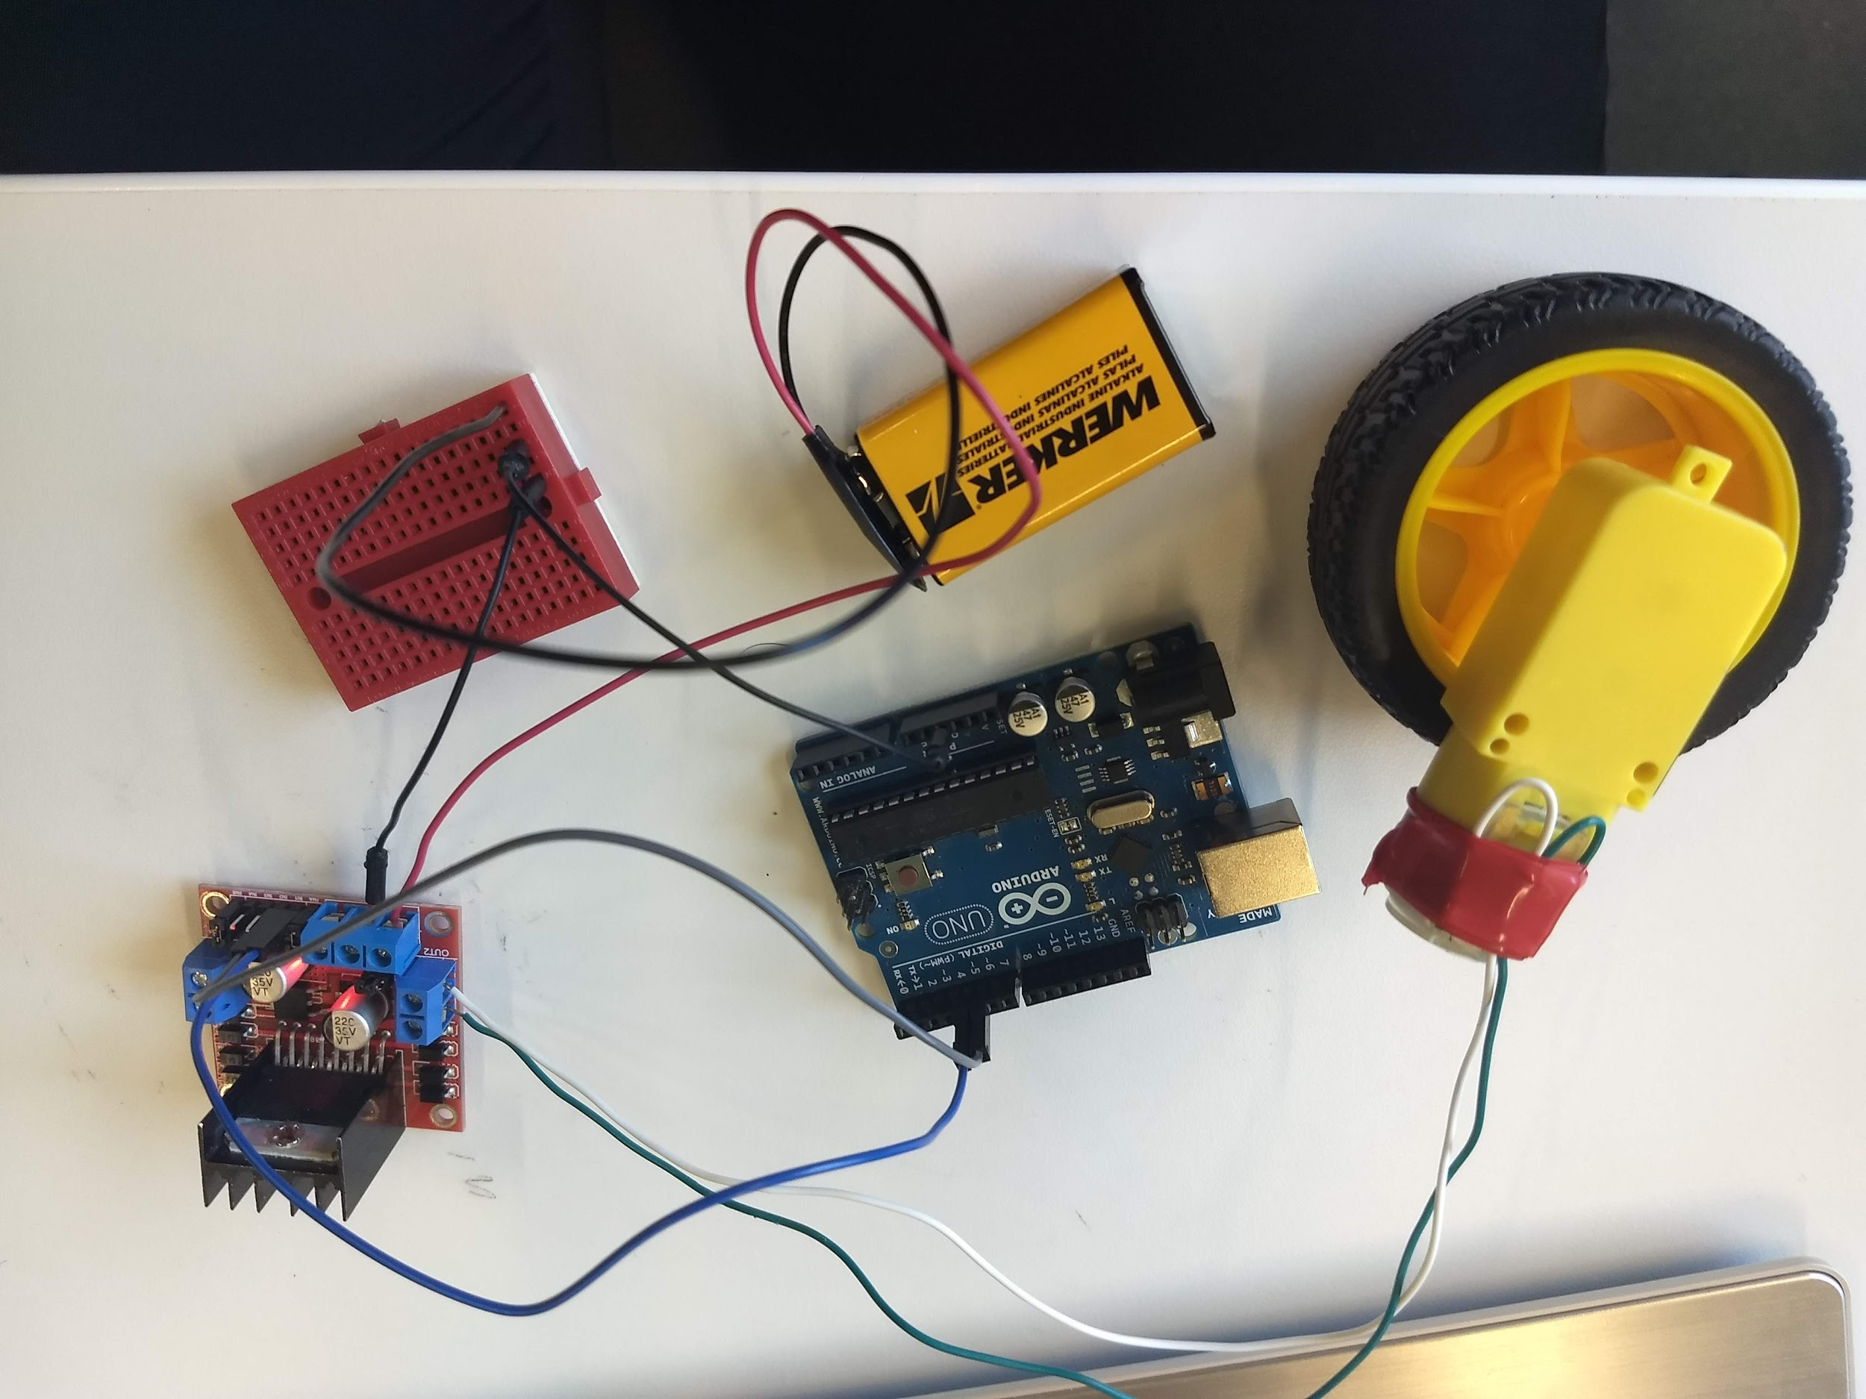
H-Bridge mini project (Assembly)
Connect the Arduino to the H-Bridge

Slide 12
H-Bridge mini project (Programming)
First we need to setup some things
Define our pins as variables
pinMode(enA, OUTPUT);
pinMode(in1, OUTPUT);
pinMode(in2, OUTPUT);

Slide 13
H-Bridge Motor Driver (Programming)
Recall that electricity flows from HIGH to LOW, just like water

Slide 14
H-Bridge mini project (Programming)
Using our knowledge of power flow, how do you think our logic will look like for the H-bridge?
Code:
digitalWrite(in1, HIGH);
digitalWrite(in2, LOW);
What do you think will happen if we change it to
digitalWrite(in1, LOW);
digitalWrite(in2, HIGH);
What if they are both HIGH?
What if they are both LOW?
Notes:
Solution H-Bridge_intro_1.ino

Slide 15
H-Bridge mini project (Assembly)
We can also control the speed of the motor using the H-Bridge
First, remove jumper over ENA
Connect Arduino to H-Bridge
You must use a PWM pin on the Arduino for this task
Remember a PWM pin have a (~) next to the number

Slide 16
H-Bridge mini project (Programming)
Declare ENA pin as variable
In setup:
pinMode(ENA, OUTPUT);
In loop
analogWrite(ENA, 50);
Now try different values in analogWrite
Notes:
Values in analogWrite should be between 0 and 255
Solution: H-bridge_intro.ino

Slide 17
H-Bridge mini project (Programming)
Possible incorporation of more involved project
https://howtomechatronics.com/tutorials/arduino/arduino-dc-motor-control-tutorial-l298n-pwm-h-bridge/

Slide 18
Section 2:
Building a Car

Slide 19
Learning objectives
In this section we will learn about
How to build a basic car
How to program a basic car
Basic problem solving regarding problems with code

Slide 20
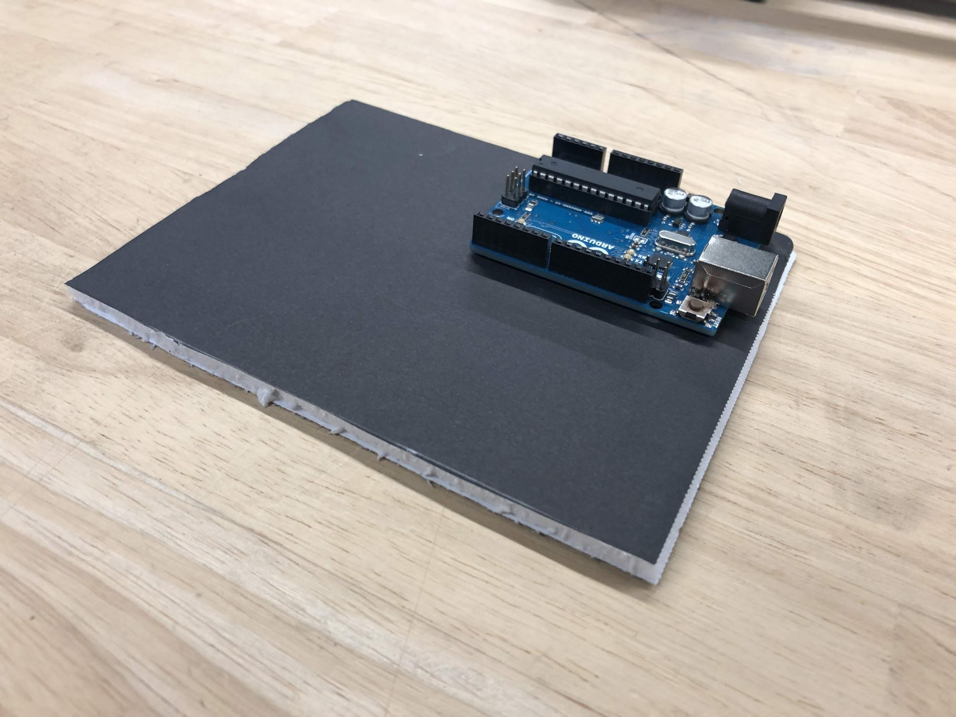
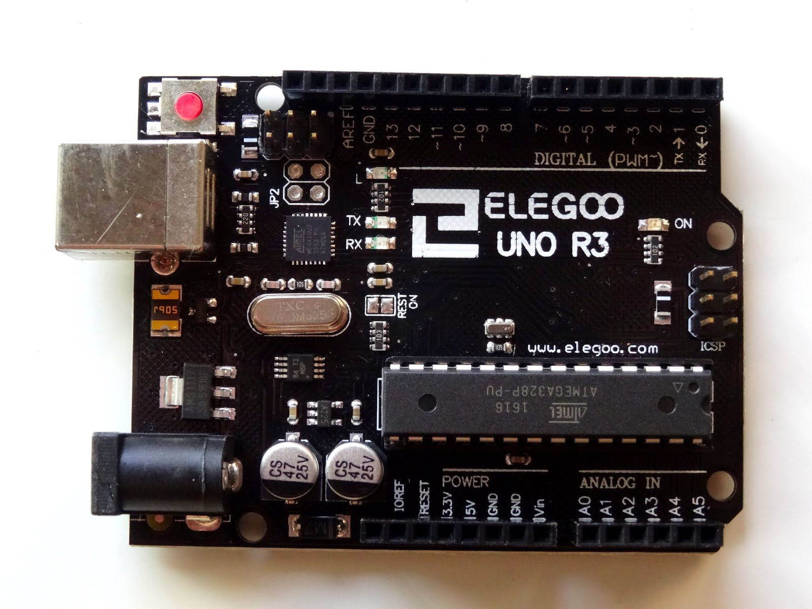
Assembly
Attach the Arduino to the foam board

Slide 21
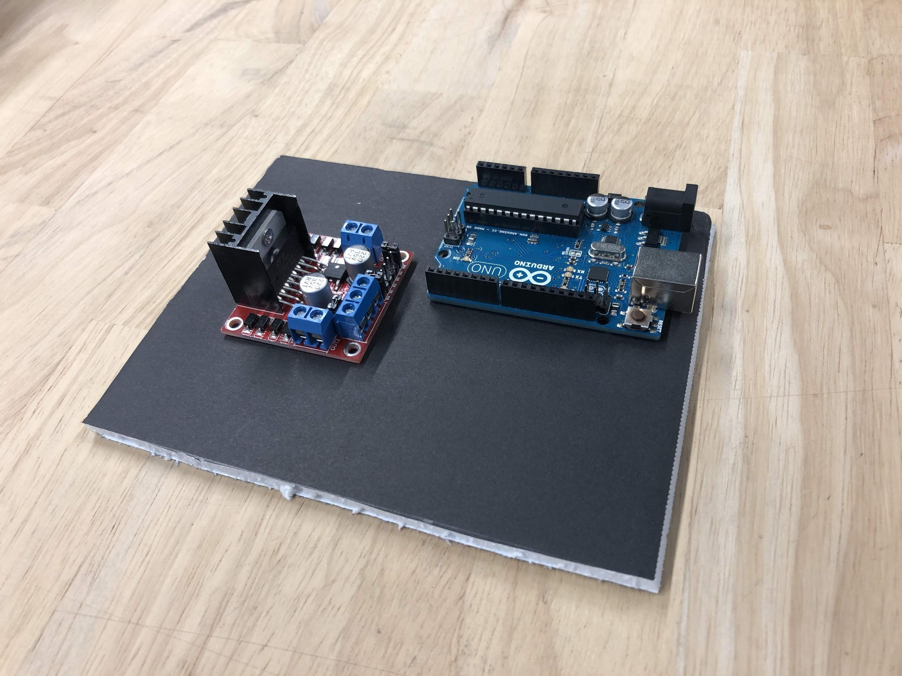
Assembly
Attach the H-bridge to the foam board

Slide 22
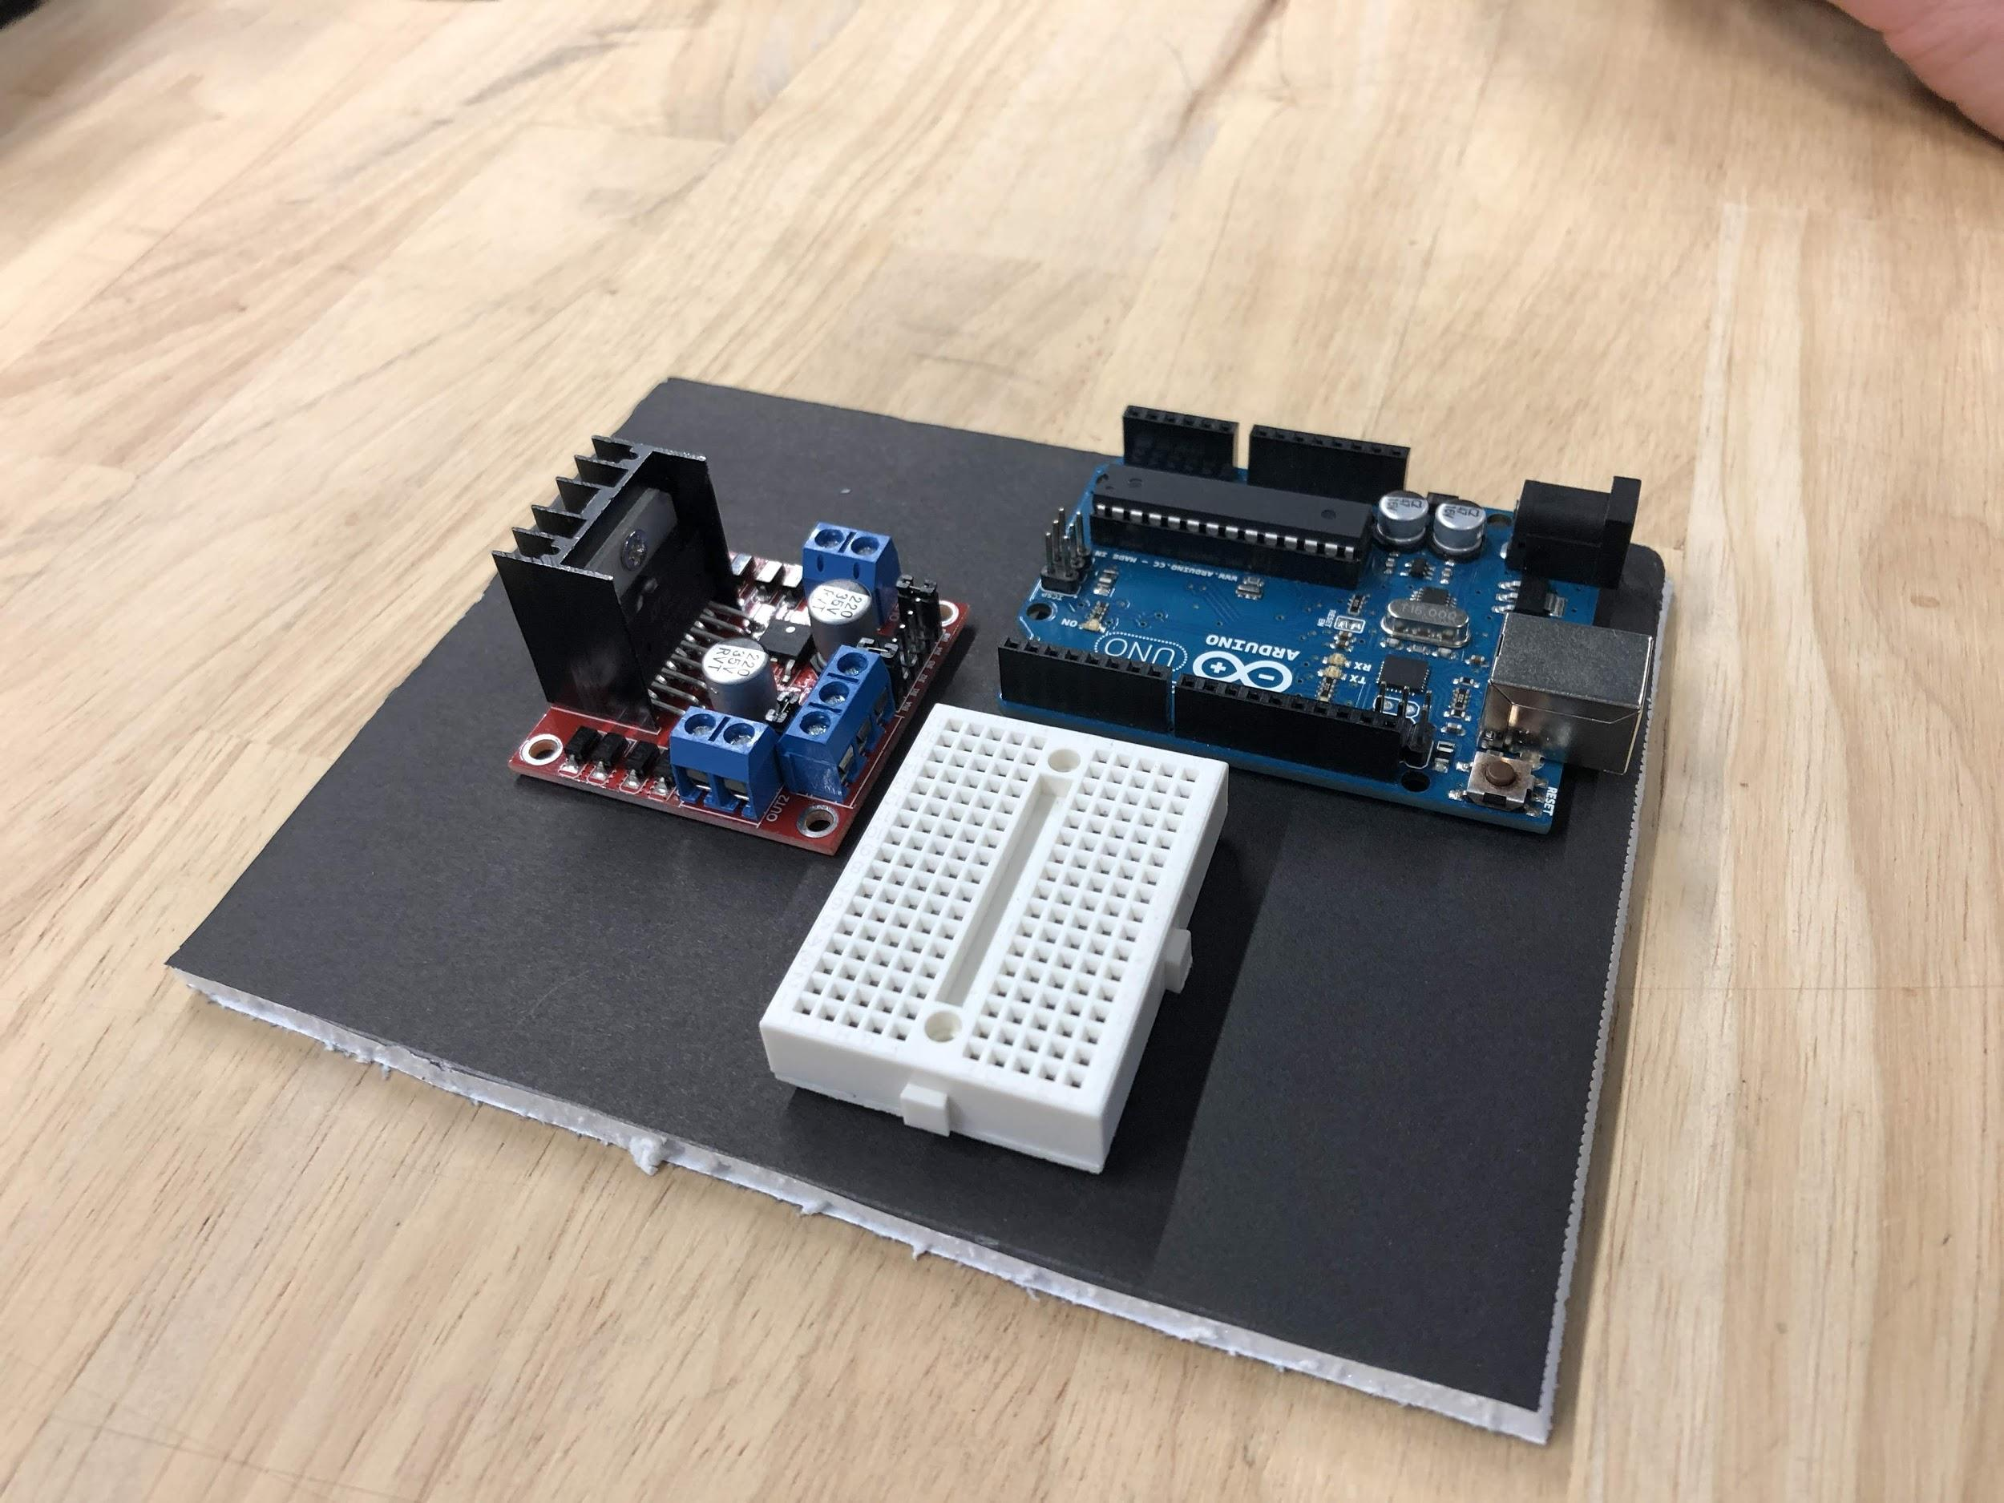
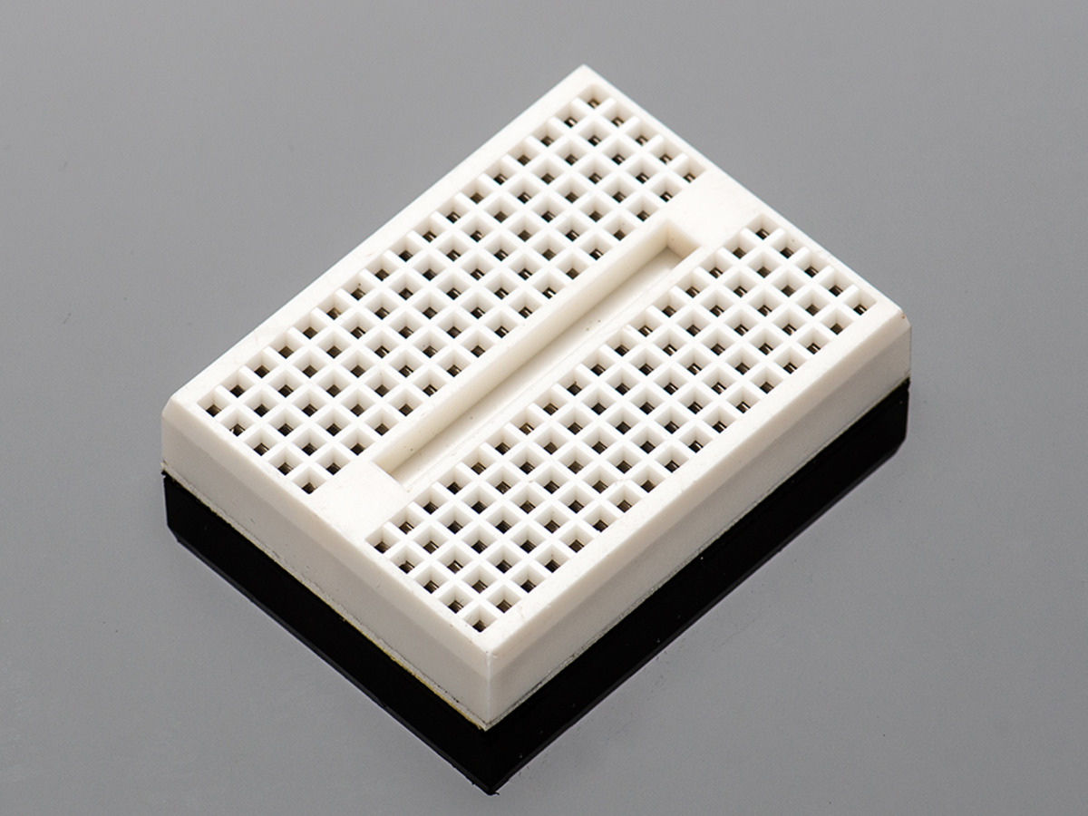
Assembly
Attach the (mini) breadboard to the foam board
IMPORTANT: DO NOT use the adhesive provided on the back side of the breadboard

Slide 23
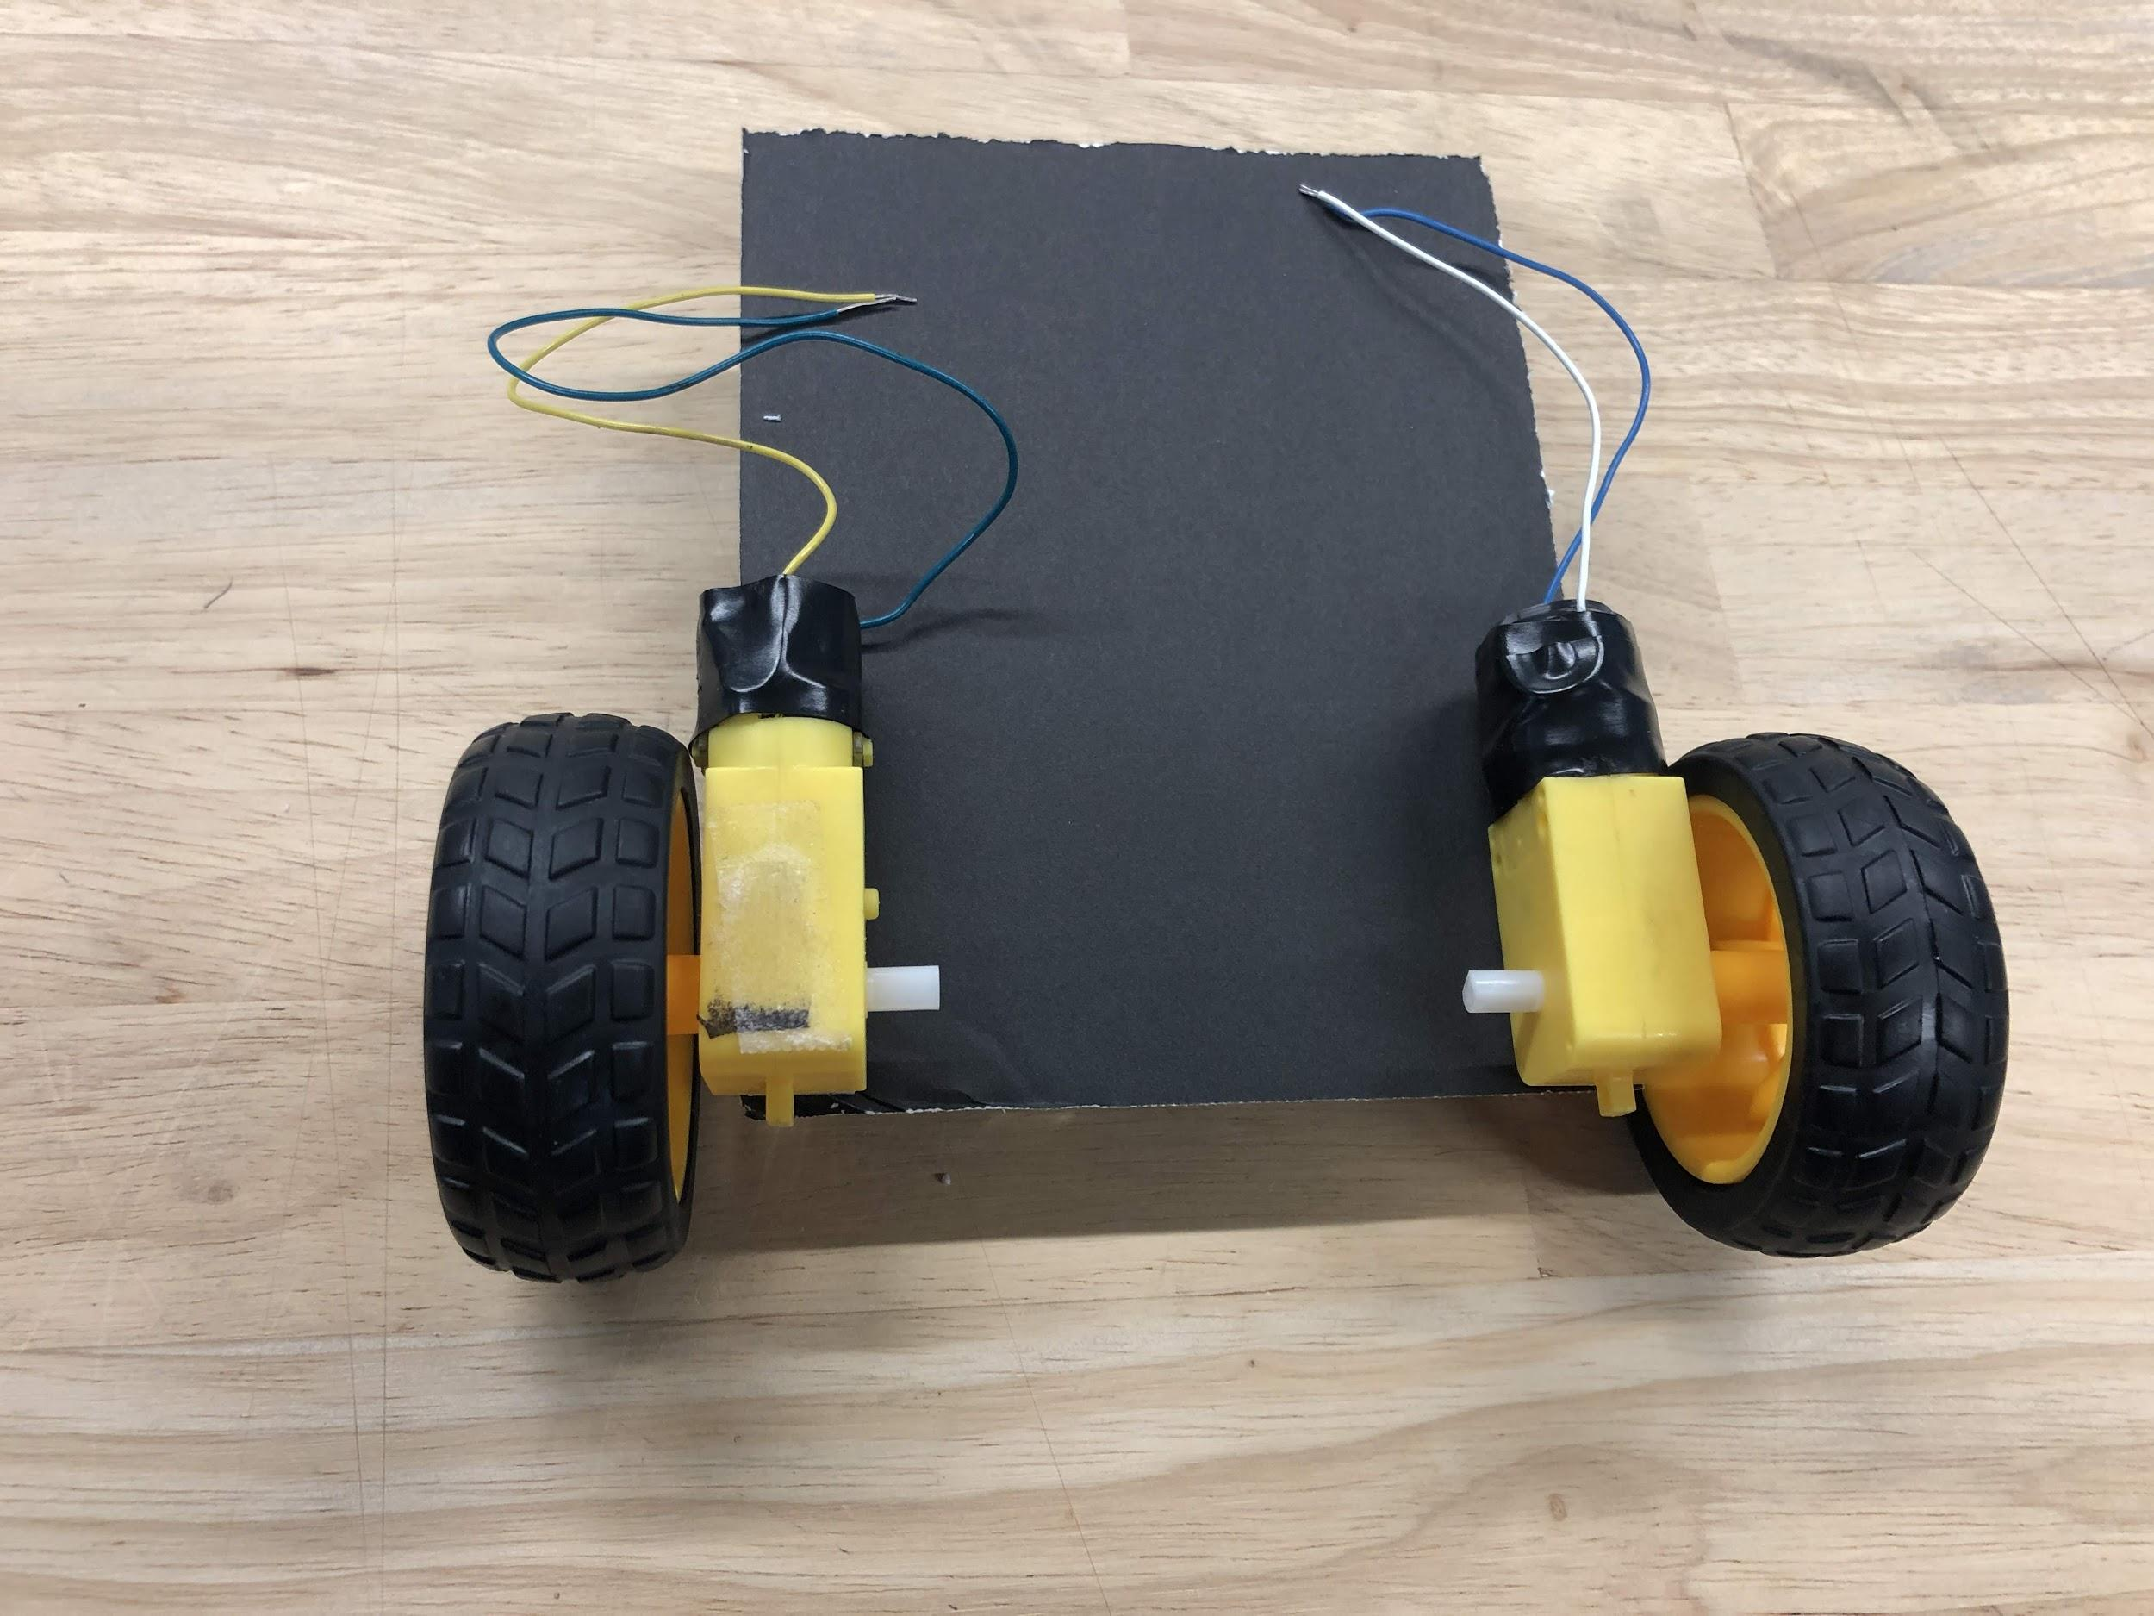
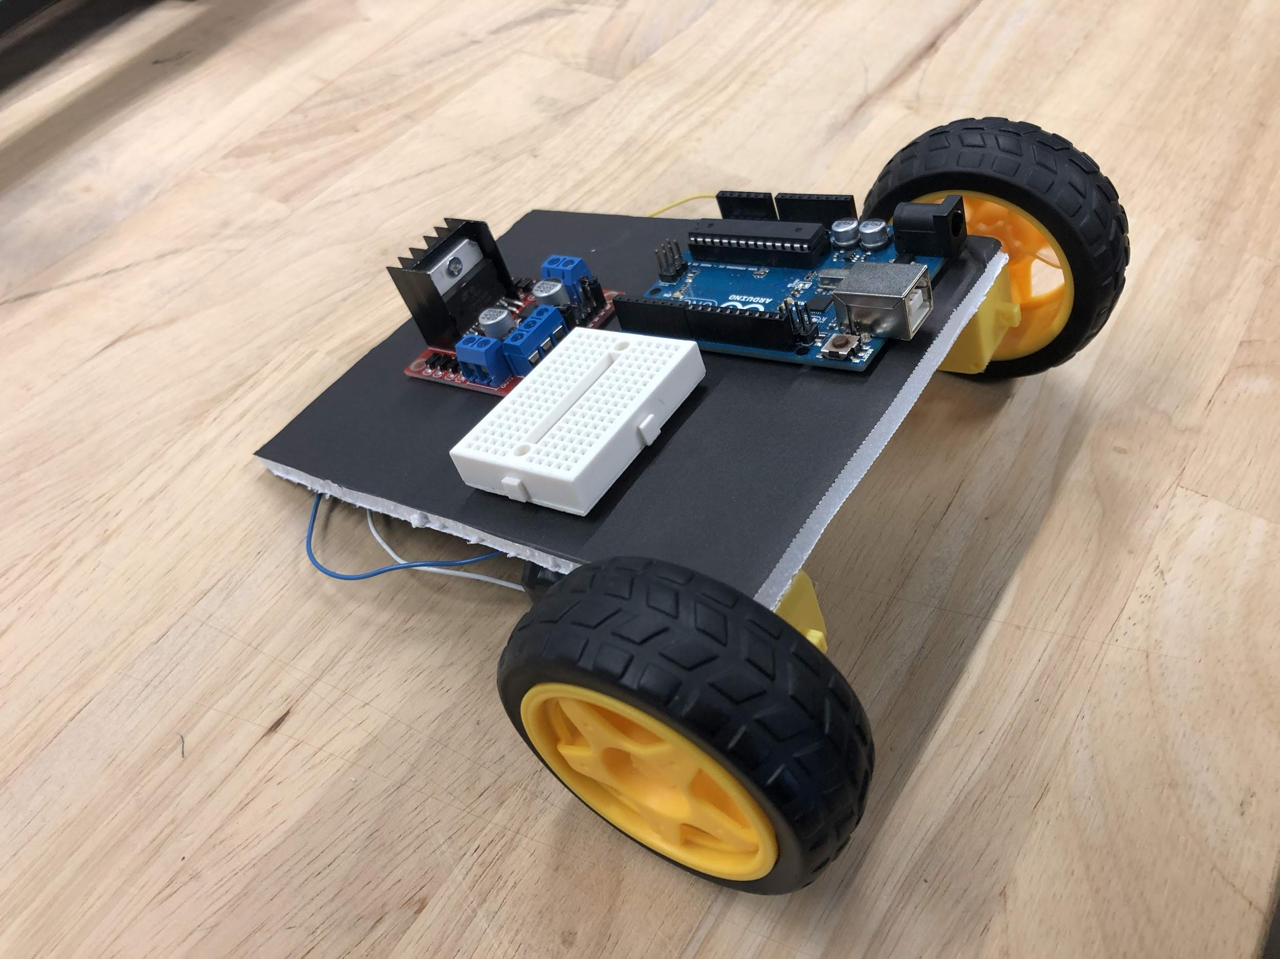
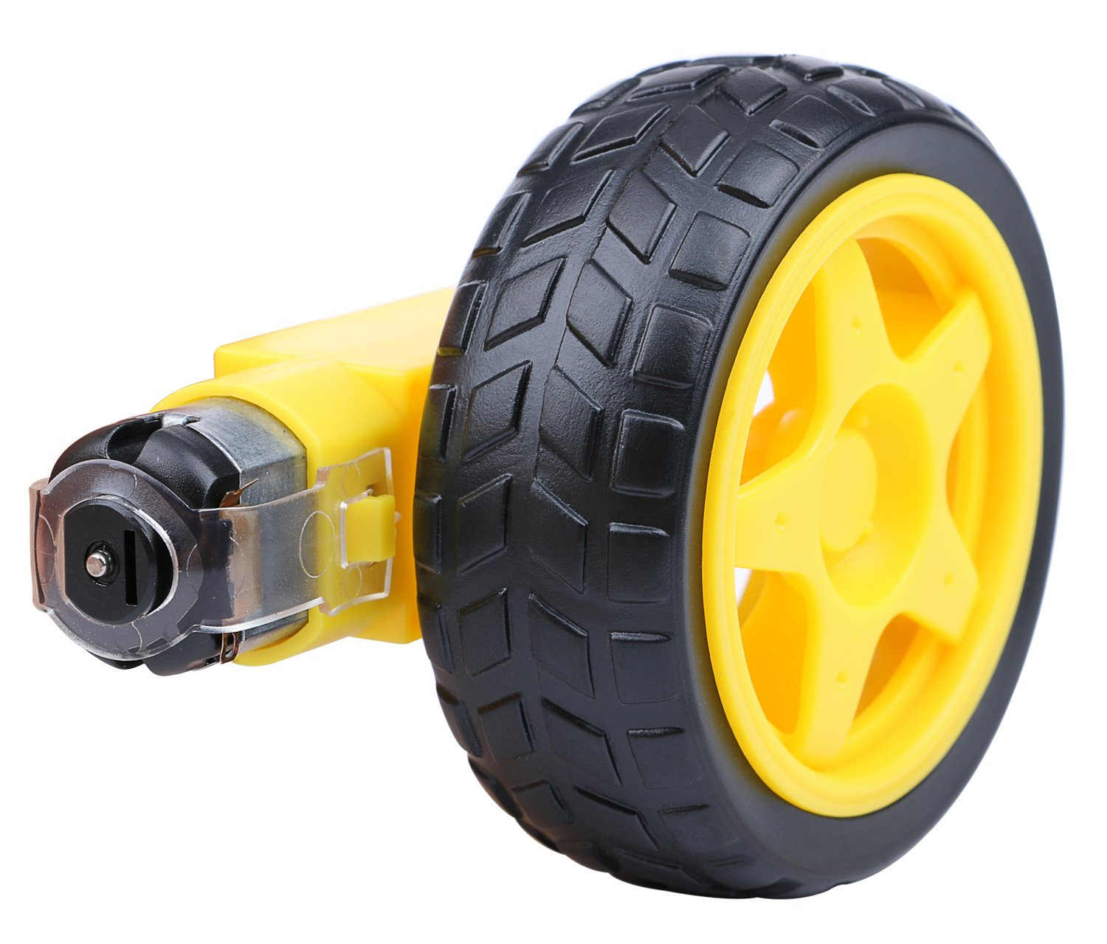
Assembly
Attach the motors to the bottom of the foam board
Looking at the back of the robot, the screws should be facing the left

Slide 24
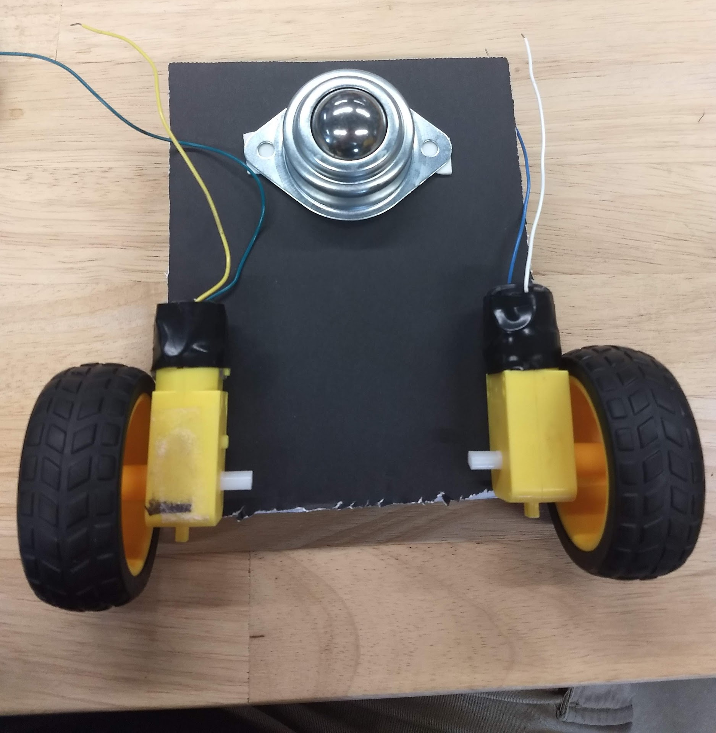
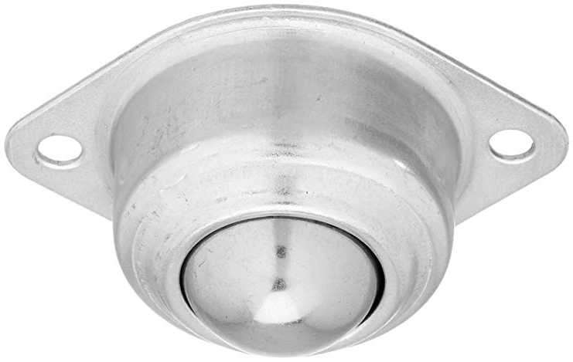
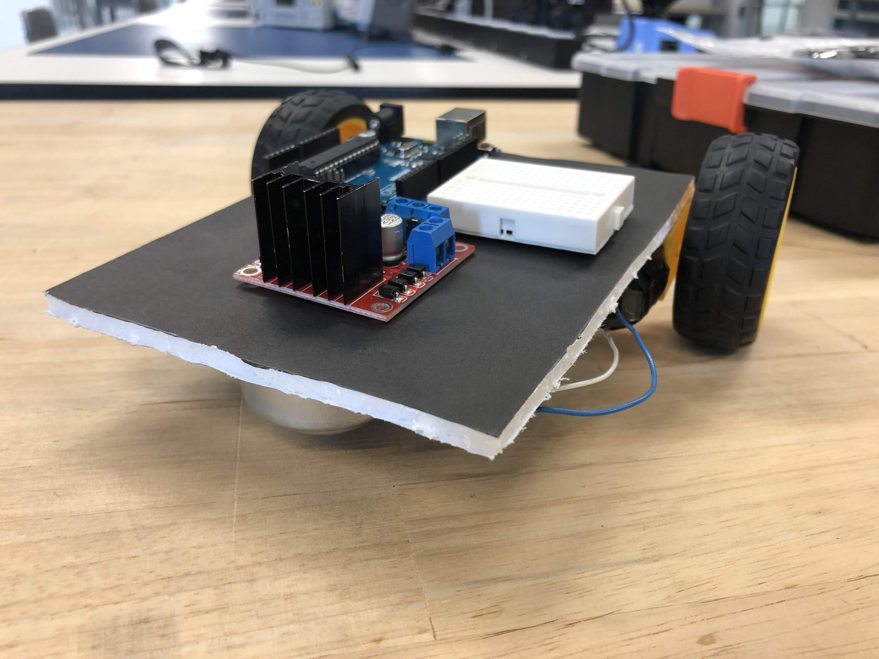
Assembly
Attach the ball bearing to the foam board
There may be some residual oil on it that must be wiped off in order for the adhesive to stick

Slide 25
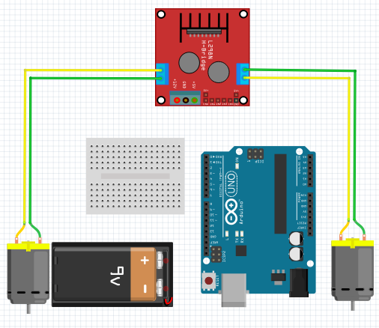
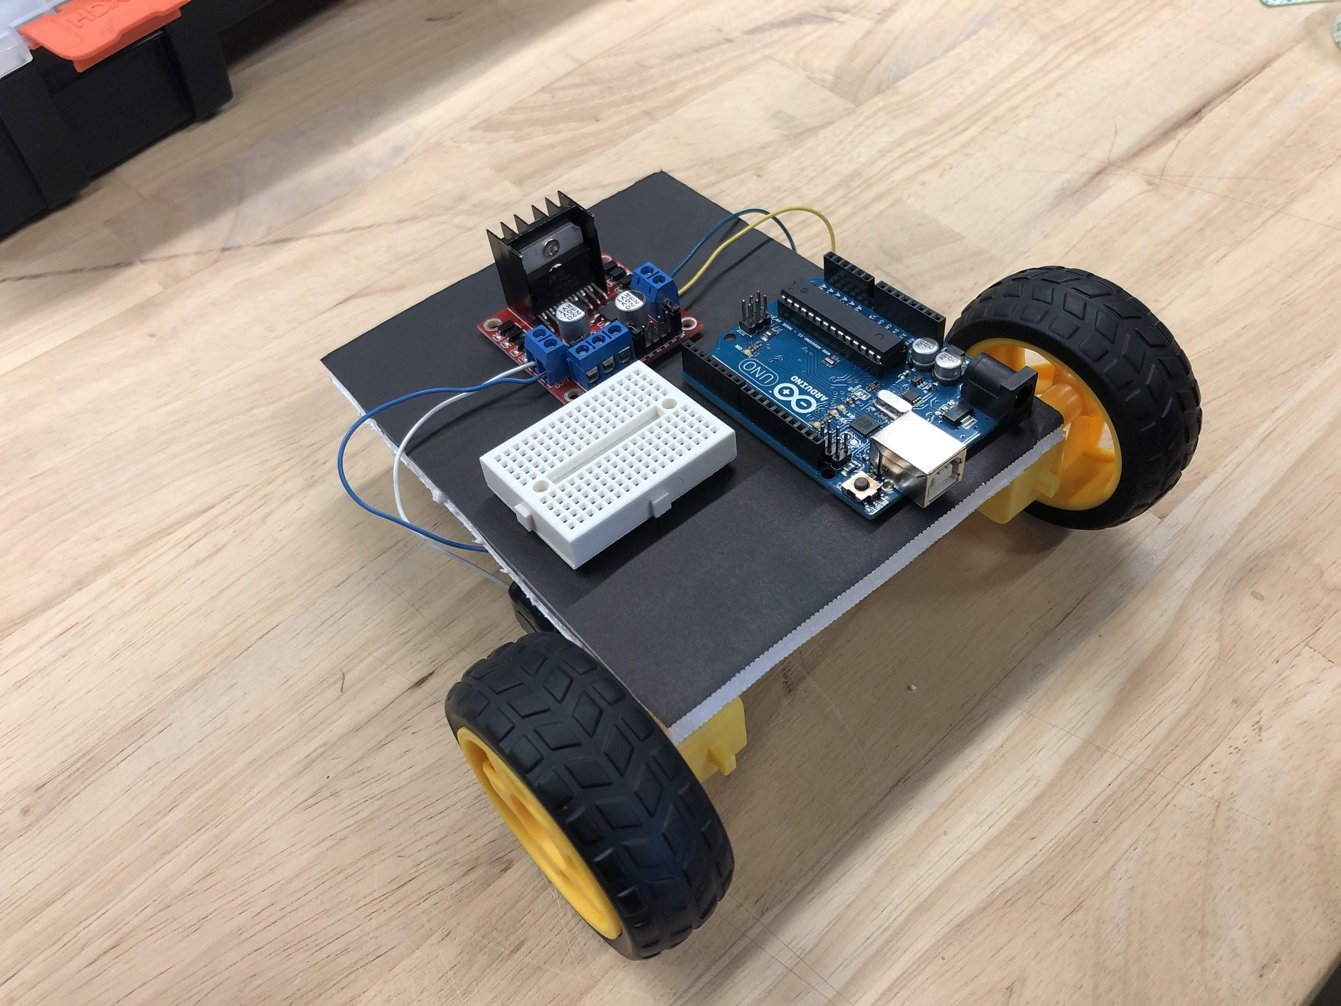
Wiring
Attach the motor wires to the H-bridge
Darker wires to OUT2 & OUT4 and lighter wires to OUT1 & OUT3

Slide 26
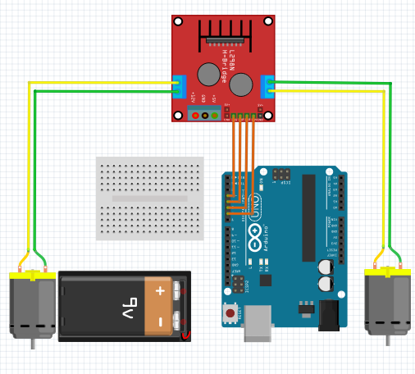
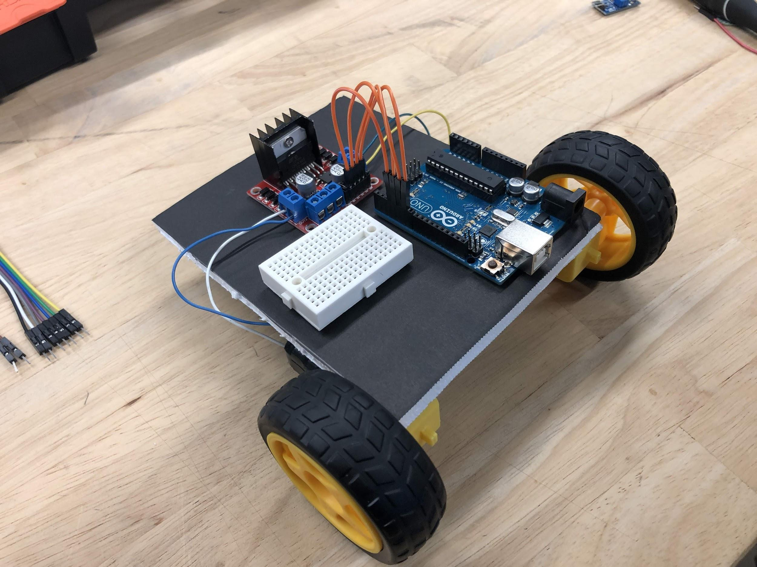
Wiring
Attach the Arduino to the H-bridge

Slide 27
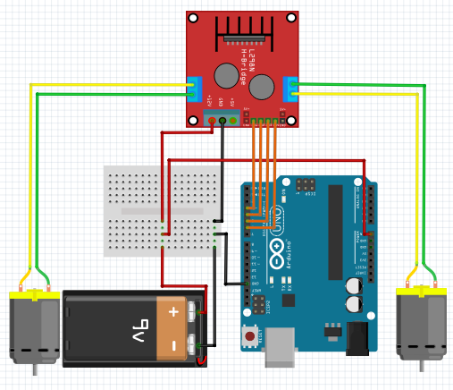
Wiring
Connect the power supply (battery + to 12V, battery - to breadboard, breadboard to GND x2, 5V to Vin)

Slide 28
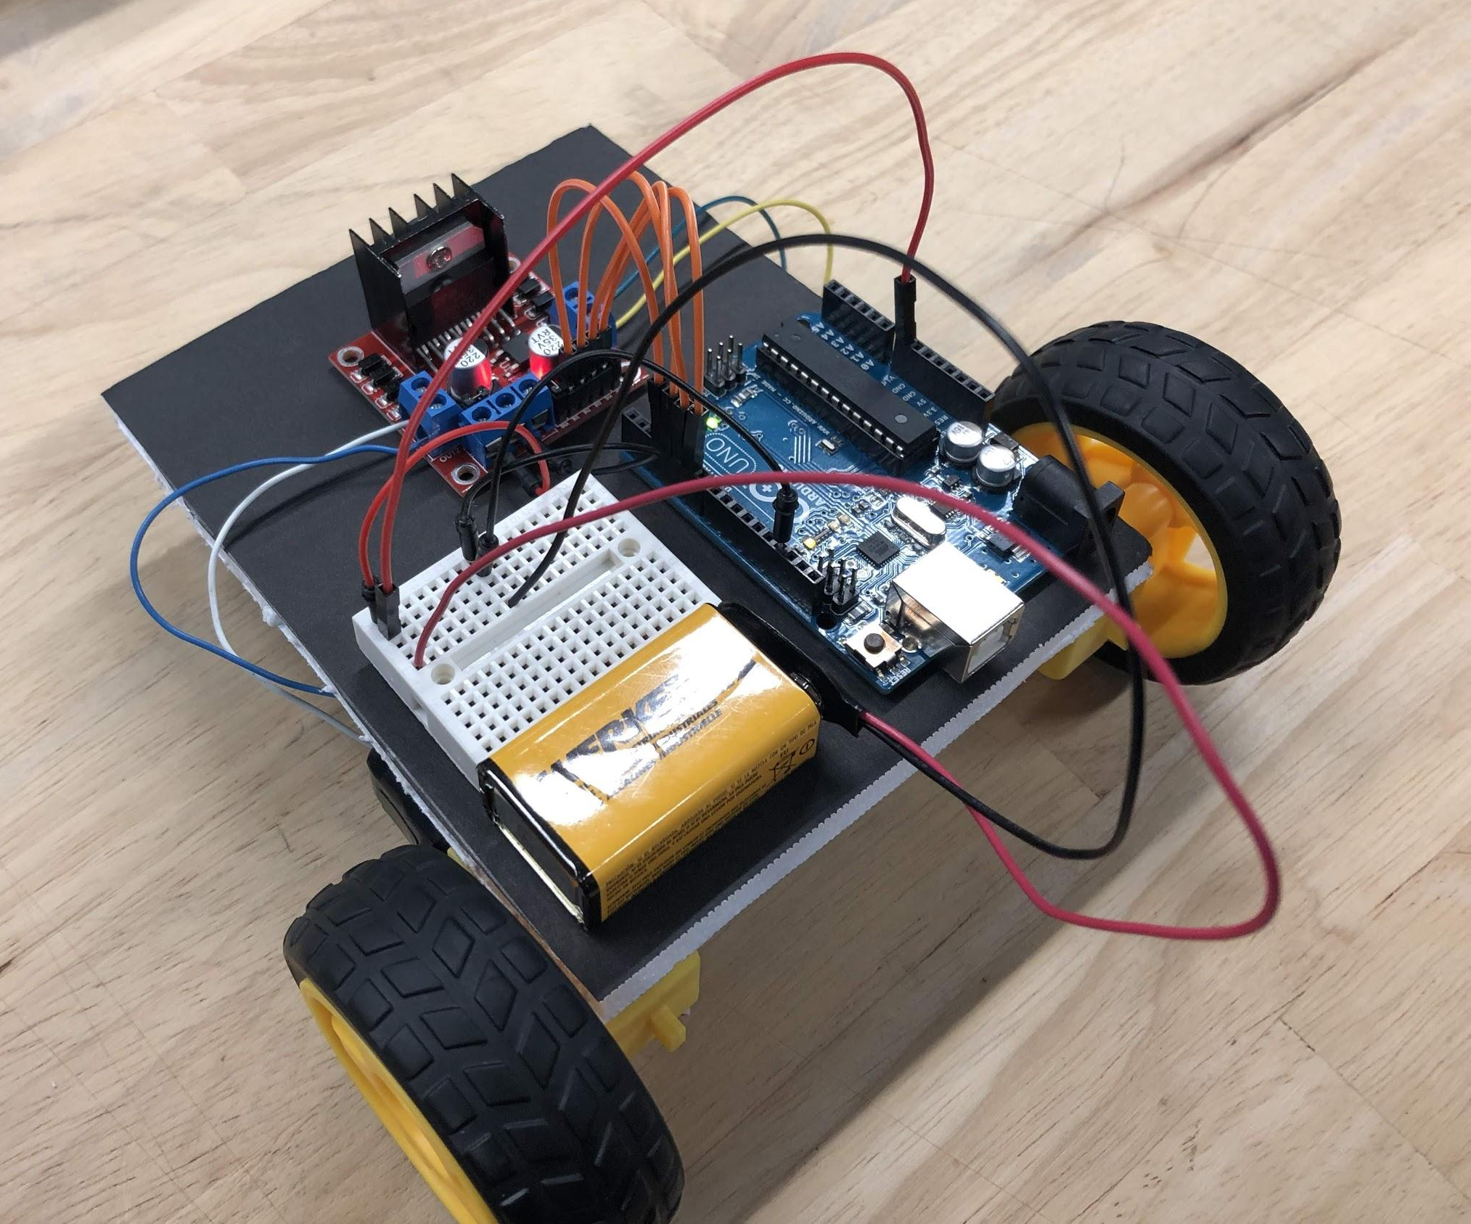
Completed Car

Slide 29
Programming
Using the knowledge from previously in the lesson. Write the code to make the car go forward
Remember:
Power flow goes from HIGH to LOW
Motor leads are red for positive and black for negative
Do NOT connect the battery and the USB at the same time, this will ruin the Arduino

Slide 30
Programming
Can you make the car go backwards?
What about making the car turn?
Notes:
Solution: Car.ino
Possible activity: build a small course for the students to try and complete using their car. It may be difficult to program them perfectly, but this also provides a good lead-in as to why we would want feedback for the later project (Line-bot)

Slide 31
Variations
Can you change the motor speed using Enable pins?
Remember to connect to the enable pins using PWM pins from the Arduino
Notes:
Solution: Car_enables.ino

